Slide 1
Data visualization and color theory
GEOG4300 /6300: Intro to data science
Prof. Jerry Shannon

Slide 2
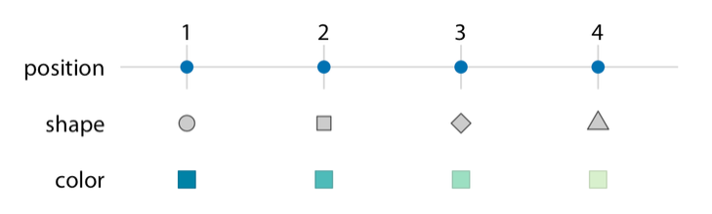
Reading review
Wilke’s chapter talks about the importance of “scales” in visualizing data. How is that relevant to this figure from the chapter?

Slide 3
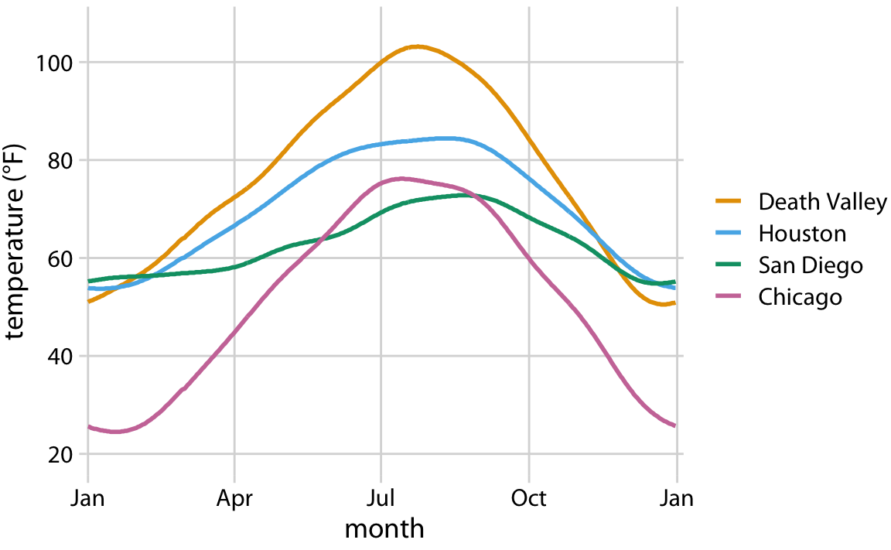
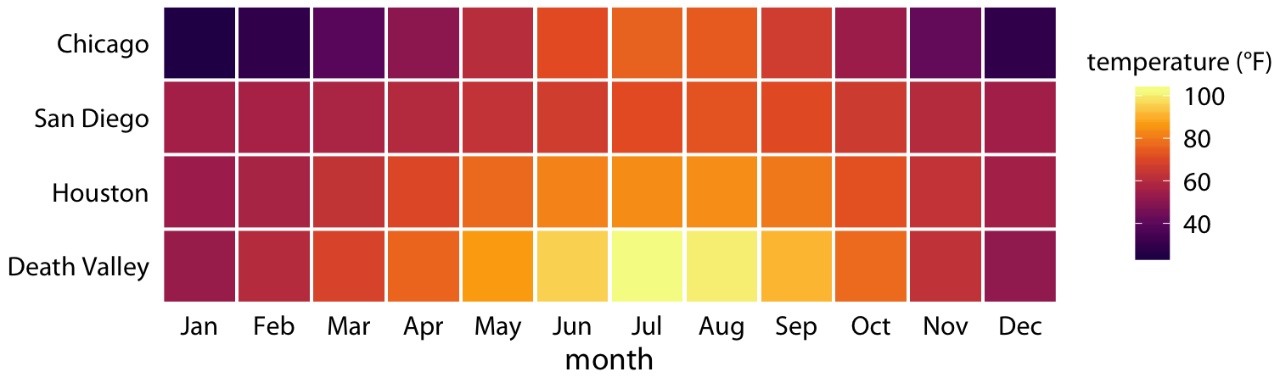
Reading review, pt. 2
How would you describe the differences in how these two figures map temperature data?

Slide 4
Reading review, pt. 2
How would you describe the differences in how these two figures map temperature data?
Figure 2.3 is a fairly standard visualization for a temperature curve and likely the visualization most data scientists would intuitively choose first. However, it is up to us which variables we map onto which scales. For example, instead of mapping temperature onto the y axis and location onto color, we can do the opposite.

Slide 5
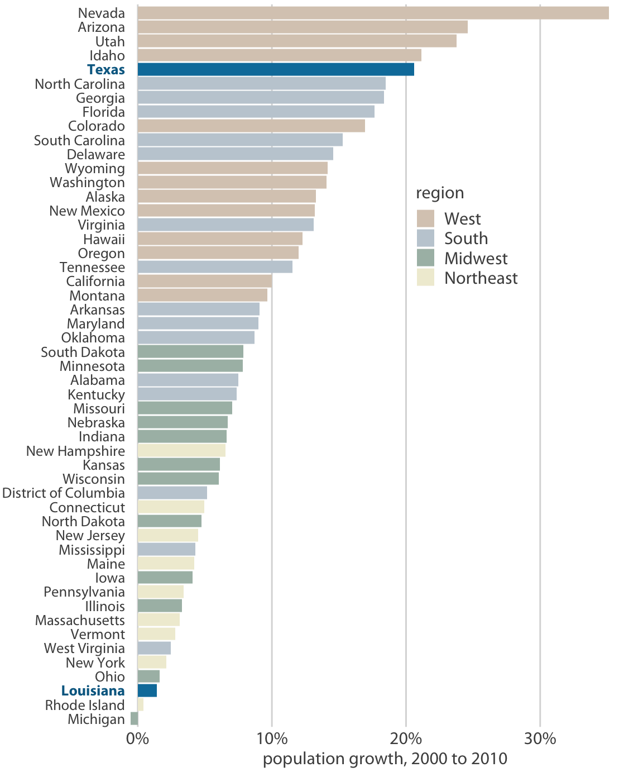
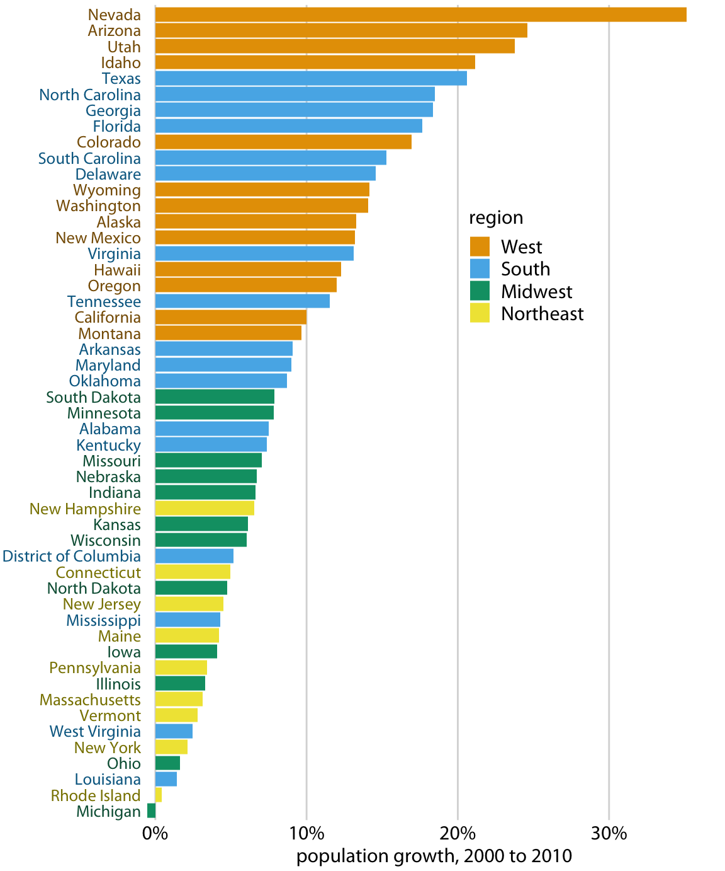
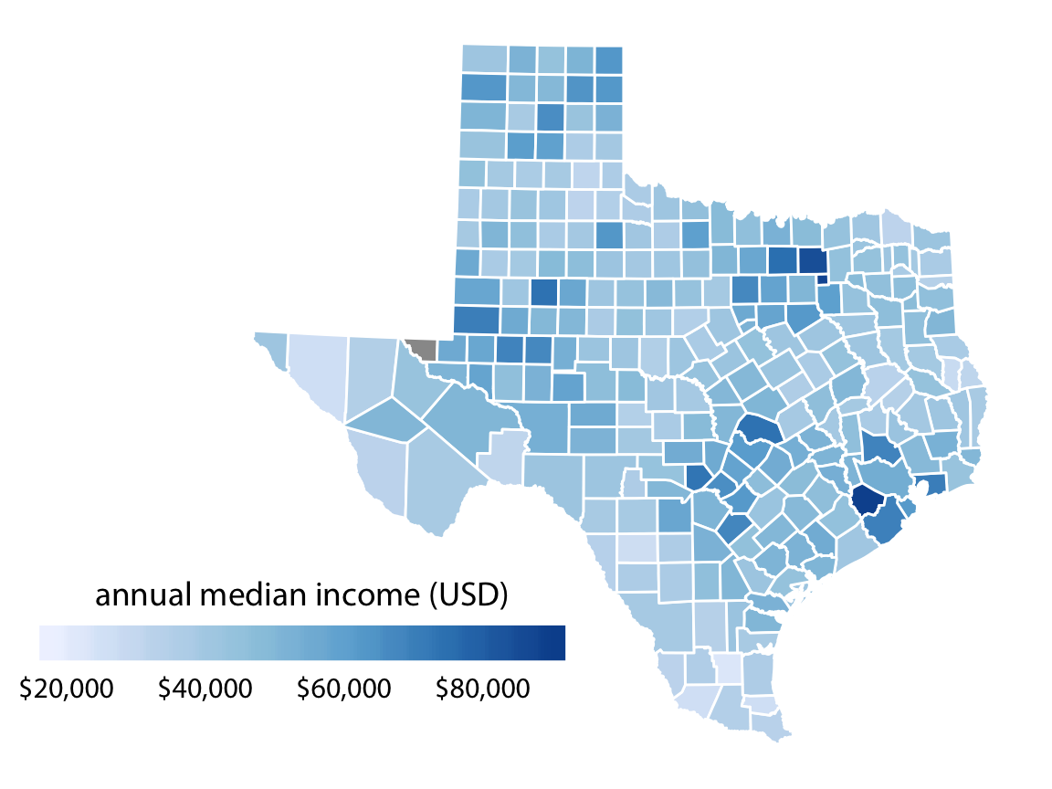
Thinking about color
How does Wilke say the following figures use color? How do they differ?

Slide 6
Going further
Pick one “Visualizing…” chapter from the book (chaps 6-16).
Which visualizations do you like/not like? What’s new to you?

